Slide 1
Sinitic Nominalization: Microvariation and Dialect Levelling (漢語方言名詞化的參數和接觸)
Keith Tse 謝嘉麒 (MCIL CL)
Ronin Institute (浪人學會)
24th Yue Dialects International Conference 2020 (第廿四屆國際粵方言研討會)
13th November 2020 (二零二零年十一月十三號)
My thanks and grateful acknowledgement to the audiences at previous conferences and editors of published volumes to whom my earlier work on Chinese nominal constructions was presented and submitted, especially IACL-25 (ELTE, Budapest, Hungary, July 2017), Hacks (University of York, February 2019),FoCaL-1 (Chinese University of Hong Kong, May 2018), BEAL-4 (Ohio State University, USA, December 2018), FoCaL-2 (Education University of Hong Kong, July 2019), Isoctal-3 (University of Cork, Ireland, December 2019). Special thanks also to my supervisors and mentors, namely Professor Nigel Vincent, Professor Feng Sheng-Li (馮勝利), Professor George Tsoulas, Professor Giuseppe Longobardi, Professor Peter Sells, Professor Ian Roberts, Professor Edith Aldridge. I wish you were here right now to watch me present this!

Slide 2
Nominalisation in Chinese (漢語名詞化)
(Ad)nominalization (Yap et al (2011)):
Adnominaliser (結構助詞): de (的)/ ge (嘅/个) ([t-]/[g-])
Possession (cf English ‘s):
我的車 (Mandarin)
wo de che
‘My car’
我 嘅 車 (我 架 車) (Cantonese)
ngo ge ce ngo ga ce
‘My car’ (Sio (2011:129))
Attribution:
胖 的 女人 (Mandarin)
pang de nüren
‘fat woman’
肥 嘅 女 人 (Cantonese)
pang ge neoi jan
‘fat woman’ (Sio (2011:129))
Multiple nominal functions >
Differential functional heads in nominal domain
(Paul (2019))

Slide 3
Nominalisation in Chinese dialects: microvariation (漢語名詞化的參數)
Adnominaliser (結構助詞): de (的) vs ge (嘅)
Tang (2011)/鄧 2008; 2009; 2010: North vs South (南北非是) (鄧 2009:243)
Chinese cleft constructions (是-的/係-嘅: COP + de/ge):
*佢 係 琴日 買-嘅 非 (Cantonese)
keui hai kamjat maai ge fei
他 是 昨天 買-的 票 (Mandarin)
ta shi zuotian mai-de piao
‘It was yesterday that he bought tickets.’
Chinese Activity nominals (他的老師當得好):
他的老師當得好 (Mandarin)
ta de laoshi dang de hao
‘He is being a good teacher.’
*佢 嘅 老師 做 得 好 (Cantonese)
keui ge lousi zou dak hou
ge (嘅) (more marked than de (的) since it does not occur in past-time clefts or Activity nominals in subject position)
de (的) ≠ ge (嘅）

Slide 4
Chinese dialectal microvariation: VdeO vs *VgeO
de (的) vs ge (嘅) (North vs South (南北非是)?)
Wu (吳):
Xiang (湘):
吾 是 昨日 買-個 票
‘It was yesterday that I bought tickets.’ (Shanghainese)
我 是 前年 到-個 北京
‘It was two years ago that I went to Beijing.’ (Xinhua)
(Wu (2005))
俚 是 昨日 買-個 票
‘It was yesterday that you bought tickets.’ (Suzhou)
我是昨日嗮個被子
‘It was yesterday that I dried the sheets.’ (Changshou (常熟話))
(?)VgeO in central/intermediate mainland dialects
Kejia (客家):
我 係 哺日 買-介 票
‘It was yesterday that I bought tickets Beijing.’
Cantonese(粵)/Taiwanese Min (台灣閩):
*佢 係 琴日 買-嘅 非
Keui hai kamjat maai ge fei
(intended) ‘It was yesterday that I bought tickets.’ (Cantonese)
*我是在台灣出個生
(intend) ‘It was in Taiwan where I was born.’ (Taiwanese Min)

Slide 5
Chinese dialectal microvariation: ta de laoshi vs *keui ge lousi
Most dialects do not permit ge in Activity nominals:
Wu (吳):
Xiang (湘):
*吾 個 飯 吃了 蠻 久
‘I ate for quite a long time.’ (Shanghainese)
(?)我 個 籃球 打 得 蠻 好
‘I play basketball quite well.’ (Xinhua)
*俚 個 水 游-了 蠻 久
‘You swan for quite a long time.’ (Suzhou)
其個老師當得蠻好/其個籃球打得蠻好/其個棋下得蠻好
(洞口老湘語, in 楊 2014:400)
‘佢個老師當得蠻好/佢個籃球打得蠻好/佢個棋作得蠻好
He is being a good teacher’/He plays basketball well’/He plays chess well.’ (贛方言吉安話, in 楊 2014:400)
*我 個 飯 吃了蠻久
‘I ate for quite a long time.’ (Changshou)
Kejia (客家):
*我 個 酒 喝得 好開心
‘I drink very happily.’
Cantonese (粵) and Taiwanese Min (台灣閩）
*佢嘅老師做得好
(intended) ‘He is being a good teacher.’
*伊個籃球打甲真好
(intended) ‘He plays basketball really well.’
*keui ge lousi in most (if not all) dialects

Slide 6
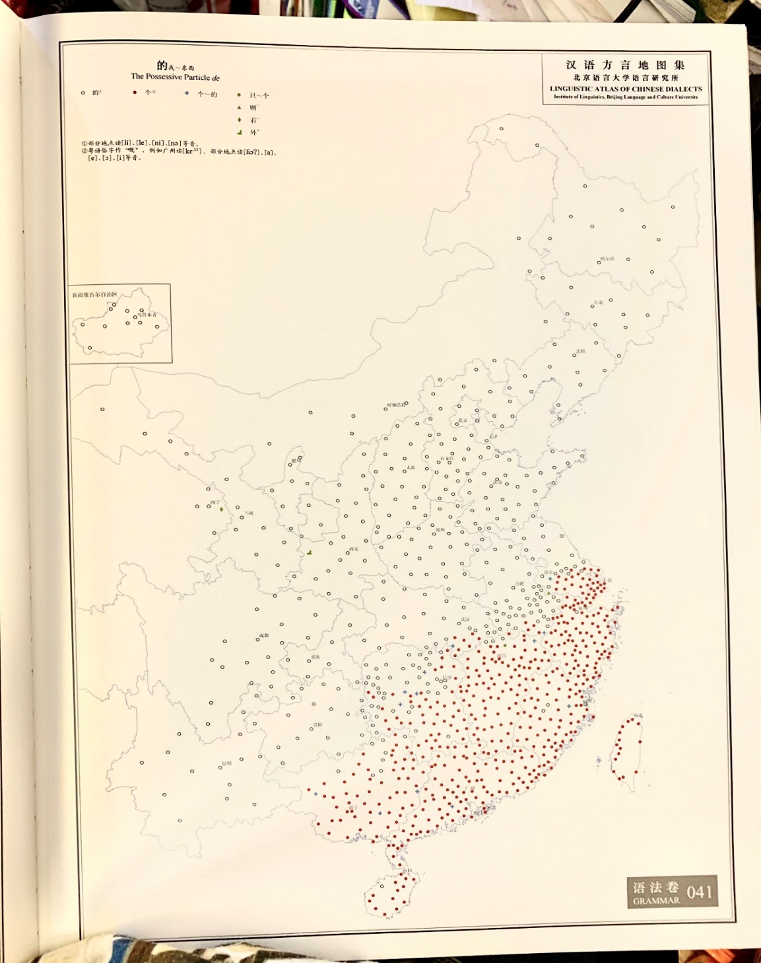
Chinese nominal microvariation: VgeO vs *keui ge lousi
(?)VgeO vs (?)*keui ge lousi
(isogloss)
Intermediate mainland dialects (Wu, Xiang, Kejia)
Chinese nominalization (de/ge):
Dialect | Past-time clefts (VdeO) | Activity nominals (ta de laoshi)
North (北方話, 東北話) | VdeO | Ta de laoshi
Central/intermediate dialects (Wu, Xiang, Kejia) | (?) VgeO | (?) *keui ge lousi
South (Cantonese, Taiwanese Min) | *VgeO | *keui ge lousi

Slide 7
Summary: Research Context and Empirical Questions
Tang (2011): Mandarin/Northern de (的) vs Cantonese/Southern ge (嘅/個/个):
e.g. clefts (VdeO vs *VgeO), Activity nominals (ta de laoshi vs *keui ge lousi)
Intermediate dialects (e.g Wu, Xiang, Kejia): (?)VgeO, *keui ge lousi)
Three-place predicates/ditransitive verbs expressing beneficiary/frequency/duration (Sio (2011:fn 1)):
我 綁 她 (的) 架 (Mandarin)
Wo bang ta de jia
‘I kidnap her.’
我 綁 佢 (*嘅) 架 (Cantonese)
ngo bong keui ge ga
我 踢-了 兩次 (的) 球
Wo ti-le liangci de qiu
‘I played football twice.’
我 踢-咗 兩次 (*嘅) 波
wo tek-zo leungci ge bo
我 游-了 三 個 小時 (的) 泳
Wo you-le san ge xiaoshi de yong
‘I swan for three hours.’
我 游-咗 三 個 鐘頭 (*嘅) 水
Wo yau-zo saam go zongtau ge sui

Slide 8
Nominal microvariation (名詞參數)
Chinese adnominalisers (de/ge) are nominal functors (Paul (2015, 2019))
Attributional/modificational markers are relatively low on nominal spine below all the referential elements (possessives, demonstratives, numerals, quantifiers, classifiers):
DEM NUM/Q CL MOD NP
(Cheng and Sybesma (1999, 2015:3); Aoun and Li (2003:267); del Gobbo (2003:), Sio (2011:129))
張三 (的)三 本 Chomsky 的 書
Zhangsan de san ben Chomsky de shu
‘Zhangsan’s three Chomsky books’
(Saito, Lin, Murasugi (2008:121-122))
張三 (嘅) 三 本 Chomsky 嘅 書
zeongsaam ge saam boon Chomsky ge shu
‘Zhangsan’s three Chomsky books’
個 (general classifier) (CL) (曹 1995; 李 2016)
的 < 底 < 者 (phrase-final nominaliser: XP-n) (劉 2008; Aldridge 2009)

Slide 9
Chinese nominal domain (Paul (2005, 2012, 2019))
DP
SpecDP D’
D PossP
SpecPossP Poss’
Poss NumP
SpecNumP Num’
Num QP
SpecQP Q’
Q CLP
SpecCLP CL’
CL ModP
SpecModP Mod’
Mod nP
NP
de/ge
Longobardi and Silvestri (2013): POSS as a high nominal functional head
張三嘅三本Chomsky嘅書
張三本Chomsky嘅書
POSS Mod
de/ge
Rubins (1994)

Slide 10
Chinese cleft (是-的) constructions
Chinese cleft constructions (shi (是) + de (的) constructions):
SUBJECT + COP + focus + presupposition + DE
(Lee (2005:133), Paul and Whitman (2008:430), Hole (2011:1710))
COP + VOde / VdeO (Long and Xiao (2009, 2011), Zhan (2012), Long (2013))
VOge / VgeO (李 2016)
It + COP + focus (relativized element) + presupposition (relative clause) (Hedberg (2000:96))
Cleft constructions are copular (Zhan and Traugott (2012, 2017), cf Higgins (1979)).

Slide 11
Chinese copula (是/係) + relative clause (VOde/VOge)
Equational: subject and complement are co-referential
COP + VOde / VOge:
師云：“人人盡有底衣即是。”
僧云：“既是人人盡有底，用被做什摩？
Teacher says, ‘The clothes which everyone has then it is.’ Monk says, ‘As it is clothes which everyone has, why use sheets?’
師指面前狗子云：“明明個，明明個。”
僧便問師：”既是明明個，為個摩頭在裏許？
‘Teacher points at a dog ahead and says, ‘It is bright, bright.’
Monk then asks, ‘If it is bright, why is its head inside?’
In sentence-final position where there is no nominal complement, de/ge can be reanalyzed as sentence-final particle (SFP)
VOde/VOge:

Slide 12
Chinese copula (是/係) + relative clause (VdeO/VgeO)
COP + VdeO / VgeO:
Non-equational/illogical copulas (Yue (1968))
那兩個人是如此如此這般這般使的手段。
‘As for those two people, it was manipulation used in thus thus such such a way’ > ‘It was thus thus so so that those two people manipulated.’ (元雜劇)
娘原是氣惱上起的病
‘As for my mother, it was originally the illness that was contracted by getting angry.’ > ‘it was through anger that mother contracted illness.’ (金瓶梅詞話)
悟空，你是哪世修來的緣法?
‘Wukong, as for you, it is the karma of which life that is obtained?’ > ‘In which life did you obtain karma?’ (Xiyouji 西游記)
须是先说个粗
‘First one must deal with it.’ (朱子語類)
须是把做个题目
‘First one must create topic.’ (同上)
只是寻个是处
‘Only seek a point.’ (同上)
VdeO/*VgeO:
ge retains quantificational meaning and tends to modify either the object noun or the event

Slide 13
Chinese Activity constructions
Subject-Object Asymmetry (黃 2008; 鄧 2009):
他 當 他 的 老師 (Mandarin)
ta dang ta de laoshi
他 的 老師 當 得 好
ta de laoshi dang de hao
‘He is being a good teacher.’
佢做佢嘅老師 (Cantonese)
keui zou keui ge lousi
*佢 嘅 老師 做 得 好
keui ge lousi zou dak hou
‘He is being a good teacher.’
Light Verb Analysis (黃 2008; 鄧 2009; 2010):
DO + VP
[DO [GP ta de dang laoshi]]
[dang i [GP ta de t i laoshi]]
[DO-P ta dang i [GP ta de t i laoshi]]
[DO-P [GP ta de t i laoshi] j [dang i t j [de hao]]

Slide 14
Chinese Activity (Light Verbs)
他 當他的老師 當得 好 (Mandarin)
keui zou keui ge lousi zou dak hou
‘He is being a good teacher.’
佢 做 佢 嘅 老師 做 得 好 (Cantonese)
keui zou keui ge lousi zou dak hou
Theta-criterion: one theta-role per argument (胡 2016, cf Chomsky (1981))
DO + DONE + VP
Actor
Activity
[DO-P ta dang i [DONE-P ta de laoshi dang i [VP t i ]]
[DO-P keui zou i [DONE-P keui ge lousi zou i [VP t i ]]
Ta de laoshi (Mandarin)/
*keui ge lousi (Cantonese)
in SpecDONE (Activity)

Slide 15
Chinese Activity nouns (ta de laoshi vs *keui ge lousi
de (的) vs ge (個):
只道自己的鐧與槍舞得好
‘thinking that he wields his arms and weapons well.’ (隋唐演義)
他的棋子雖然下得極高
‘Although he plays well extremely well…’ (二十年目睹之怪現狀)
貴教師的中國話說得很好
‘You teacher speaks Chinese excellently’ (文明小史，第十三囘)
後面個僧祗對看
‘The monk behind you can only stare.’ (景德傳燈錄，卷八)
用汝個月作麽？
‘What use is your moon?’ (同上)
但只硬把定中間個心
‘But holding the heart in the middle by force…’ (朱子語類）
ge (個) as classifier has count and individualizing function ->
ge cannot select Activity NP

Slide 16
Chinese nominal domain in intermediate dialects
(?)VgeO vs *keui ge lousi
吾 是 昨日 買-個 票 / *吾 個 飯 吃-了 蠻 久
‘It was yesterday that I bought tickets.’ / ‘I ate for quite a long time.’ (Shanghainese, Wu)
我 是 前年 到-個 北京/(?)我 個 籃球 打 得 蠻 好
‘It was two years ago that I went to Beijing.’ / ‘I play basketball quite well.’ (Xinhua, Xiang)
我 係 哺日 買-介 票 / *我介步跑得好
‘It was yesterday that I bought tickets Beijing.’ (Kejia)
VgeO (non-referential) vs *keui ge lousi (referential)
Possessive (+D)

Slide 17
Chinese nominal domain (final)
DP
SpecDP D’
D PossP
SpecPossP Poss’
Poss NumP
SpecNumP Num’
Num QP
SpecQP Q’
Q CLP
SpecCLP CL’
CL ModP
SpecModP Mod’
Mod nP
NP
de/ge
+D
+D pre-empts past-time clefts (*VgeO) and Activity nominals (*keui ge lousi)
de/ge
ge: +count
+count pre-empts past-time clefts (*VgeO)
and Activity nominals (*keui ge lousi)

Slide 18
Conclusions
Building on Tang’s comparison between Cantonese ge (嘅) and Mandarin de (的), intermediary mainland dialects show divergences between VgeO and *keui ge lousi
ge is more marked than de <-
classifier ge (個) (+count/individual/delimit) (Bisang and Li (2012), Zhang (2013))
Cross-dialectal comparisons have shown microvariation in the uses of adnominalisers/structural particles de (的) and ge (個)
Chinese nominal domain further microparameterised:
Dialect families/areas | Adnominaliser (結構助詞）
North | de (VdeO, ta de laoshi) (-count)
Intermediate (Wu, Xiang, Kejia) | ge (VgeO, *keui ge lousi) (+count, +/-D)
South (Cantonese, Taiwanese Min) | ge (*VgeO, *keui ge lousi) (+count, +D)
In L2-parameter resetting, (un)interpretable features may influence calque transfer (Tsimpli (passim), van Gelderen (2019)).

Slide 19
Thanks and Acknowledgements
Thank you all for listening!
多謝大家今日嘅聆聽，請大家保持聯絡！
Muito obrigado por assistirem ao meu colóquio!
keith.tse@balliol-oxford.com

